Slide 1

Life
Matthew Shang & Tenzin Low
^https://hackaday.com/wp-content/uploads/2020/04/glider.png

Slide 2

Huh? What’s Life
^https://www.istockphoto.com/photo/senior-man-shrugging-shoulders-gm91520053-8977854

Slide 3
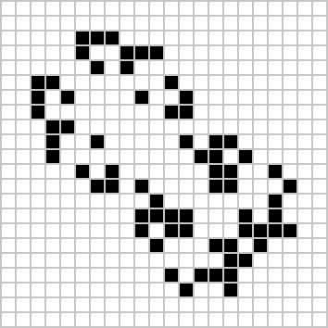
What’s a Life?
Conway’s Game of Life
Cellular Automata:
Simple Rules
Discrete state
Finite dimensions
… but Complex Behaviors!
^https://conwaylife.com/wiki/Big_glider

Slide 4
Okay, but why do these matter?
^https://www.istockphoto.com/photo/senior-man-shrugging-shoulders-gm91520053-8977854

Slide 5
Cellular Automata Are Valuable
Cellular Automata can model many things:
Magnetism by simulating atomic spins: Ising Model
Turbulent combustion
Simulating Laser Behaviors
Simulating Traffic Flow

Slide 6

Fun Fact!
Von Neumann’s Universal Constructor *predicted DNA!
Proposed cellular automaton that could self-replicate and evolve
Blueprint for machine stored on tape (sim. to DNA)
https://en.wikipedia.org/wiki/John_von_Neumann#/media/File:JohnvonNeumann-LosAlamos.gif

Slide 7

Rule 184
Cellular automata for 1-D array of cells (each in state 0 or 1)
Transition for each cell only determined by 2 neighbors + self
8 Rows in a lookup table function
Multiple interpretations!!
Traffic Flow => Critical density beyond which traffic slows
Surface Deposition => Interpret cells as describing angle of surface
Ballistic Annihilation =>
There’s a beauty here to how latent interpretations live in just 1’s and 0’s with a 8-row transition rule.
Wikipedia’s great!: https://en.wikipedia.org/wiki/Rule_184
Notes:
Surface Deposition thing is honestly crazy snazzy. Read up on Wikipedia (whoever thought of that interpretation, hats off)

Slide 8

Okay, so Cellular Automata are neat…
how do I make a Conway’s Game of Life state that evolves into a smiley face…?
Okay, So I know what you’re thinking…
^https://www.shutterstock.com/shutterstock/photos/1244323459/display_1500/stock-photo-doubts-and-people-concept-indian-man-thinking-and-looking-up-over-grey-background-1244323459.jpg
Notes:
Thought bubble appears after text as a meme. Just be aware

Slide 9

Enter SMT
Z3
These systems are mathematically defined!
Finite states + pure transition function ⇒ Prime SMT use case
https://www.shutterstock.com/image-photo/businessman-grimaces-he-raises-sword-600w-50520973.jpg

Slide 10

Enter GOLZ3
Solver-aided (Z3) tool for answering questions about Conway’s Game of Life (GOL).
Features:
Multi-timestep Predecessor search
Generalized pattern search
Game of Life Rule Synthesis*
*More of a proof of concept than anything xd

Slide 11
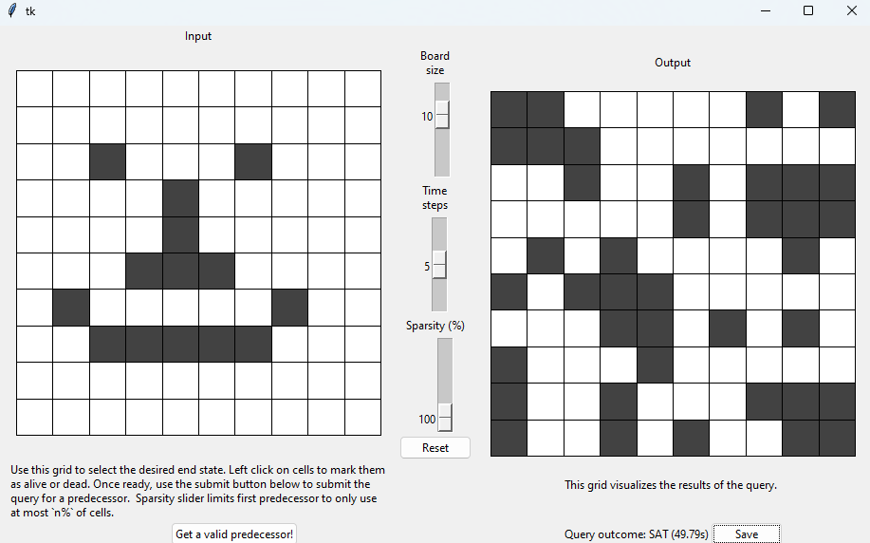
Predecessor Search
Can you find a state that evolves to this one?
We couldn’t! (Our attention span was too short)

Slide 12
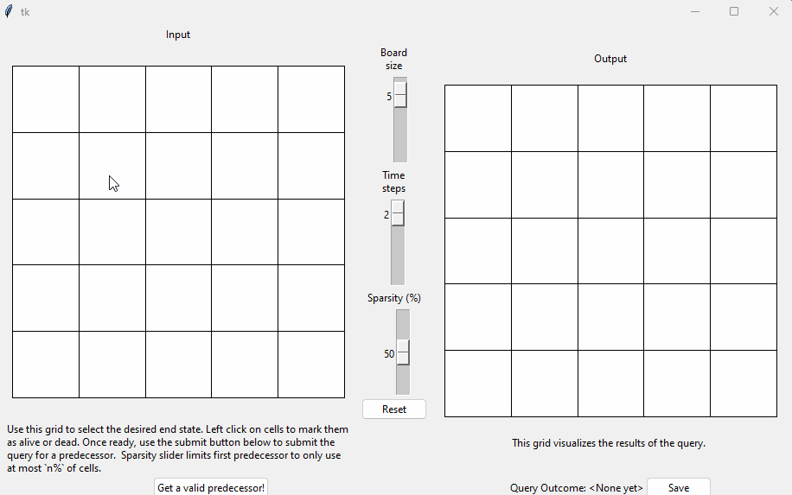
Finding Smiley
Instead we used attention span to build a tool to do it for us.
Step 1: Setup the query

Slide 13

Predecessor Search
Step 2: Profit.

Slide 14
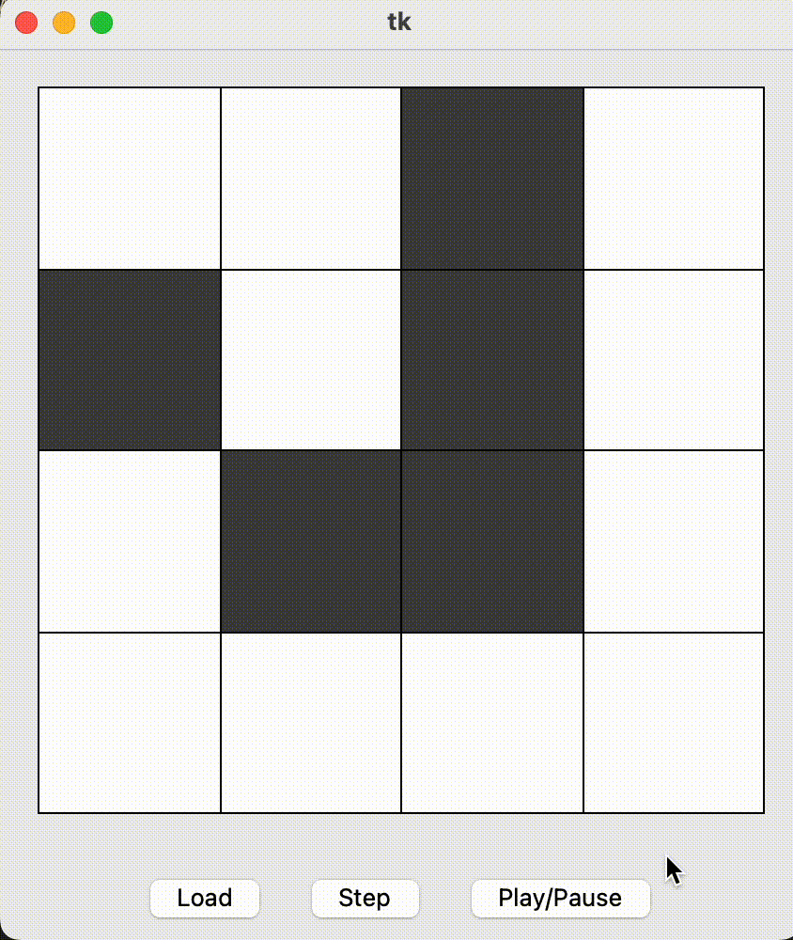
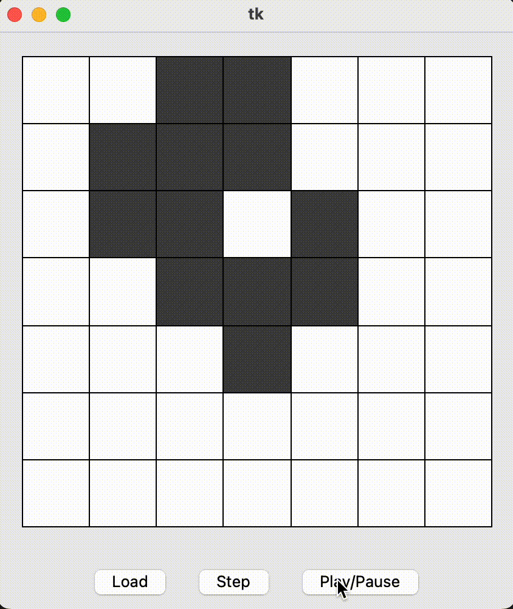
Searching for spaceships

Slide 15
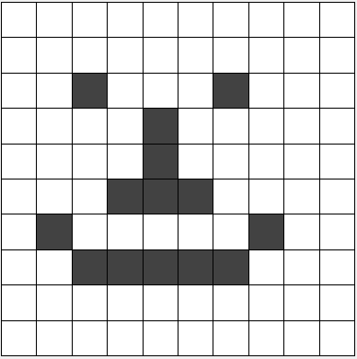
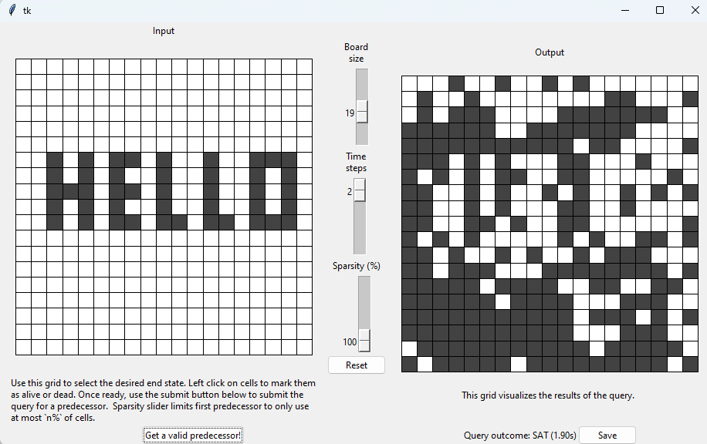
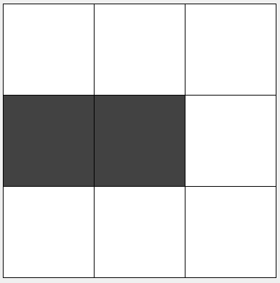
States without Predecessors
Do they exist?
Any randomly selected patterns is highly likely to have predecessor!

Slide 16
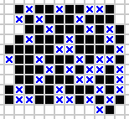
Did we find any?
No… further work needed to scale larger than 3x3.
Sped up exhaustive search over post states using incremental solving.
Verified known Garden of Eden as well.
https://upload.wikimedia.org/wikipedia/commons/9/9e/Garden_of_Eden_4.png

Slide 17
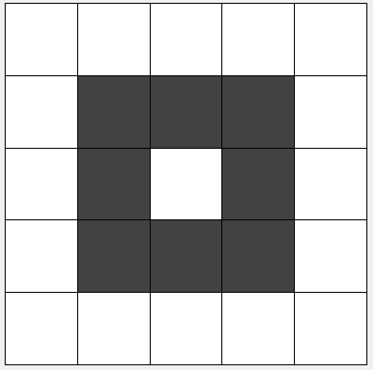
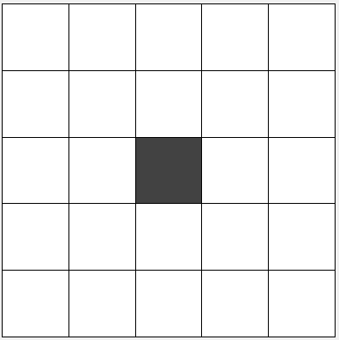
Rule Synthesis
Given a pre and post state, predict rule that relates them.
?

Slide 18
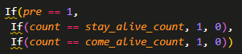
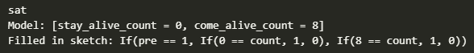
Rule Synthesis Continued
User provides Sketch with symbolic holes (vars)
Solver tries to find satisfying assignment such that concrete state works

Slide 19

Addendum: Performance Juicing
Z3
Notes:
Add notes about work we did to try and juice performance from Z3

Slide 20
Trying Different Representations
Integers
Bools
Pseudoboolean cardinality constraints
Weirdly Slow
Manually encoded boolean cardinality constraints
Python overhead :(
Conclusion: integers fastest overall

Slide 21
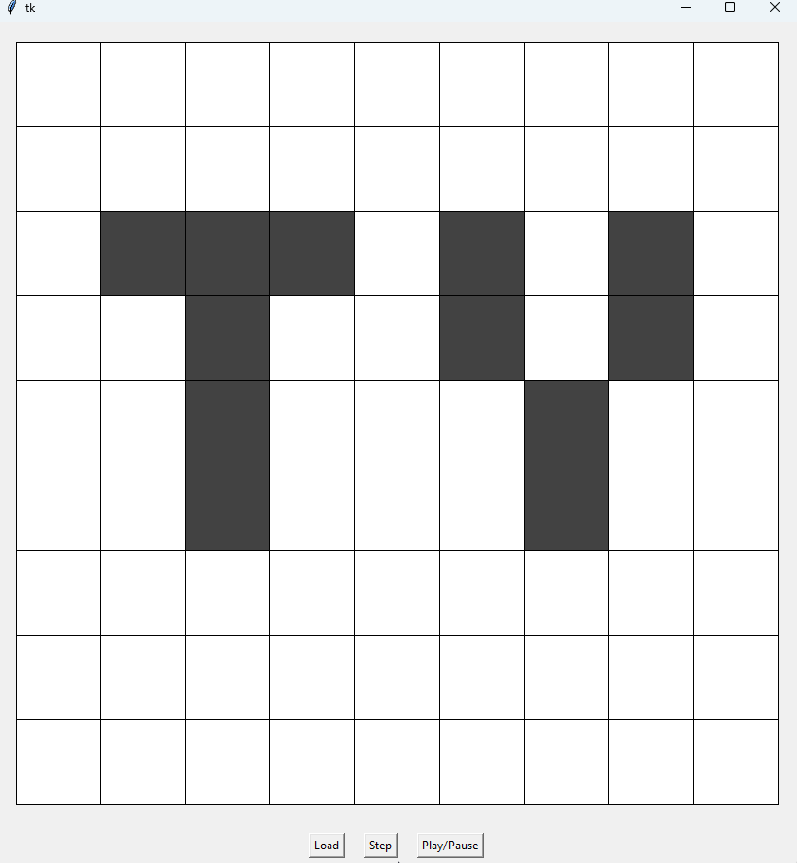
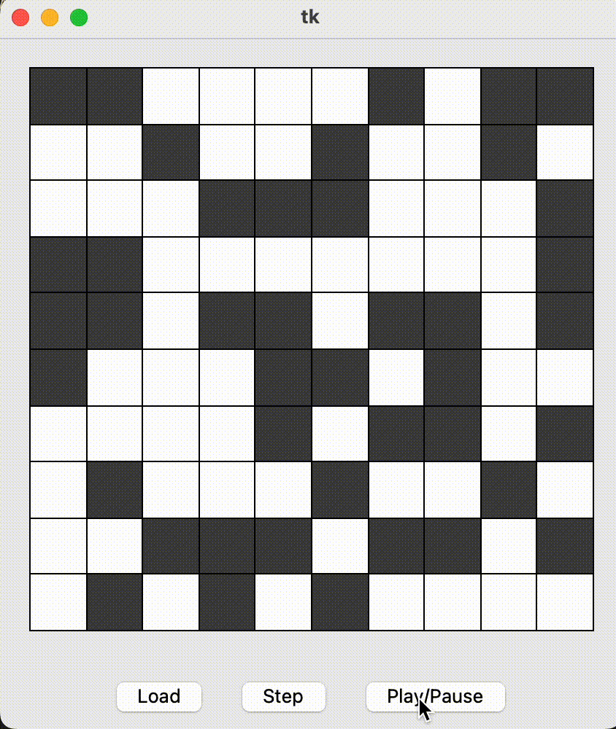
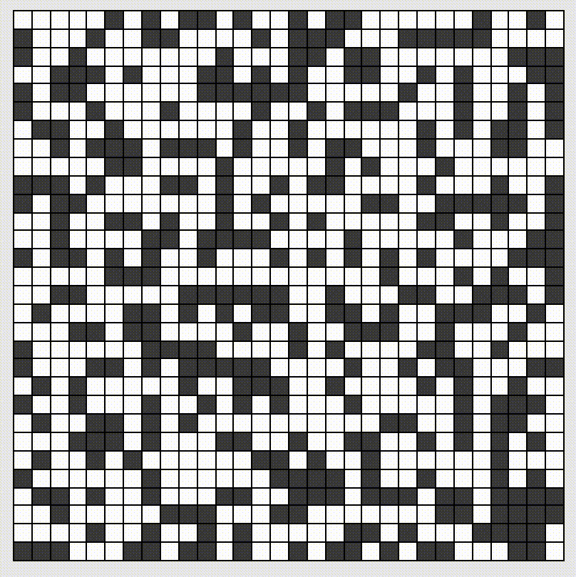

Slide 22
Once problem has been encoded, it’s actually relatively easy to develop new questions to ask

Slide 23
General Pattern Searching
Can we find a pattern that does x?

Slide 24

Garden of Eden Search
https://media.swncdn.com/via/9367-flickr-faunggs-photos.jpg
The Garden of Eden was created out of nowhere.

Slide 25


Are there any?
Are there states without a predecessor?
Yes! Called “Gardens of Eden”
1971 R. Banks finds a Conway Garden of Eden
Can we find them?
YES. Just submit query with fixed post state, query for pre-state
If UNSAT, then post-state is GoE!
?
https://cdn3.iconfinder.com/data/icons/activity-emoji/50/Gardening-512.png

Slide 26
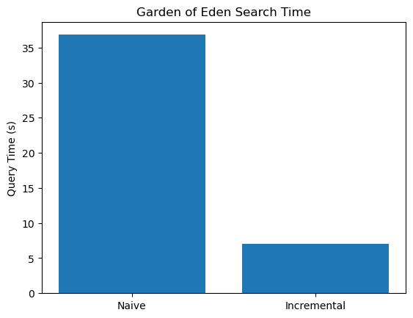
Aside on Garden of Eden Search Optimization
Using Z3’s push/pop feature to enable Z3 incremental search accelerated performance!

Slide 27


Okay, but are those even problems?
YES!
Predecessor of any state
States with no Predecessors
(Gardens of Eden)
Rule Synthesis
Given a pre and a post state, give rule that explains transition
Find periodic patterns
Find patterns that move themselves
https://t4.ftcdn.net/jpg/01/36/70/67/360_F_136706734_KWhNBhLvY5XTlZVocpxFQK1FfKNOYbMj.jpg
Is this an SMT?
https://cdn.vox-cdn.com/thumbor/8rF2keXrhL8sYlEbVbtaJpIC4qs=/0x10:500x291/1600x900/cdn.vox-cdn.com/uploads/chorus_image/image/59741997/n4scgse21iuz.0.jpg

Slide 28
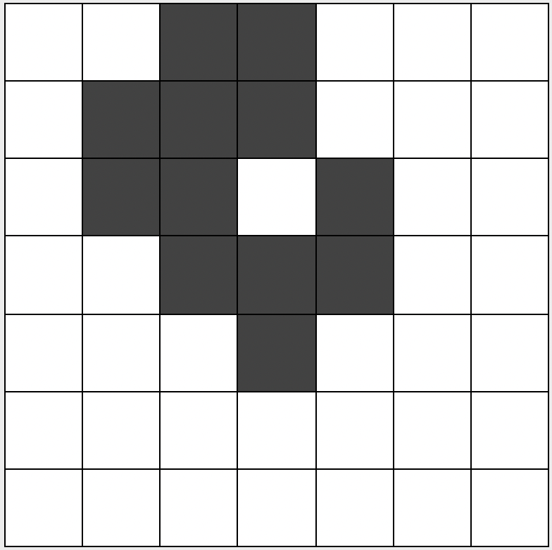
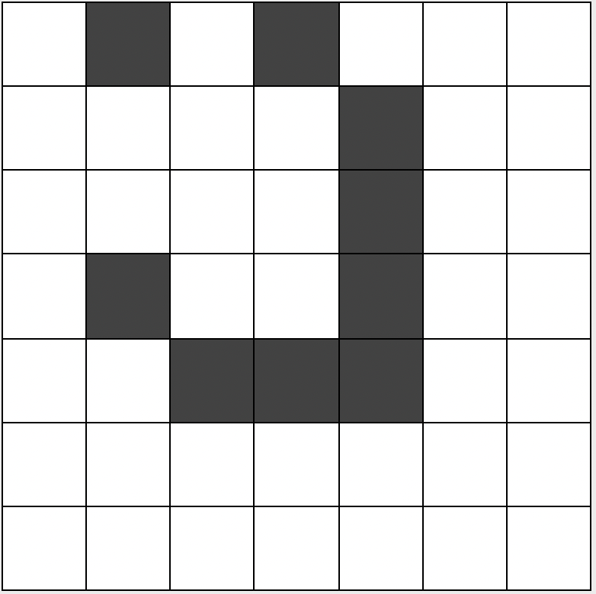
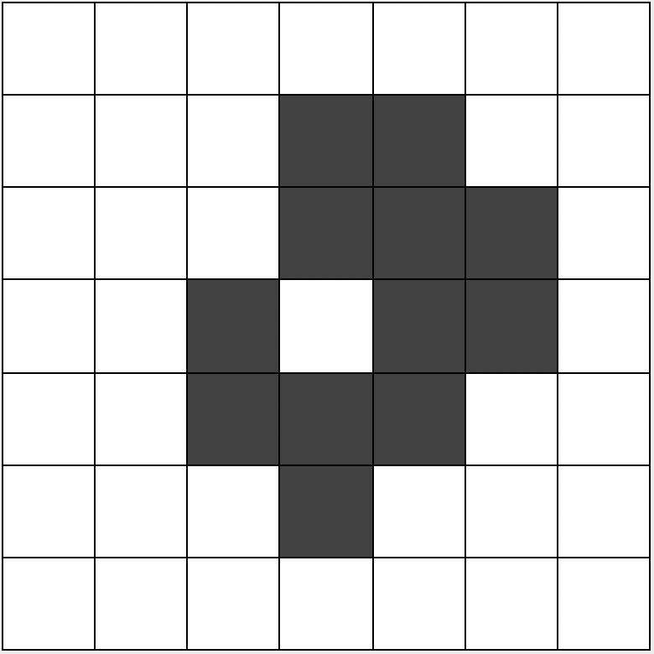
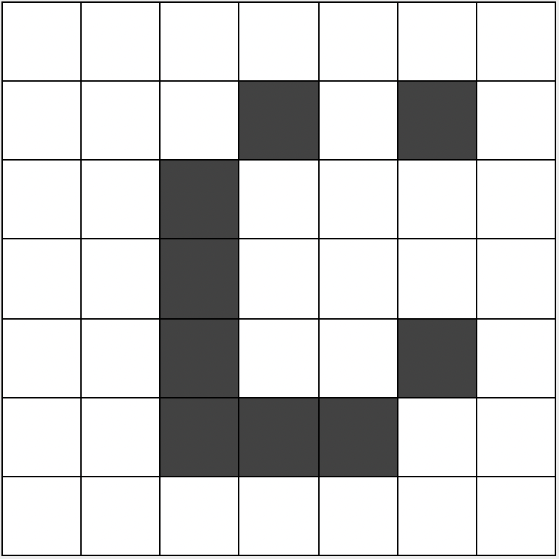
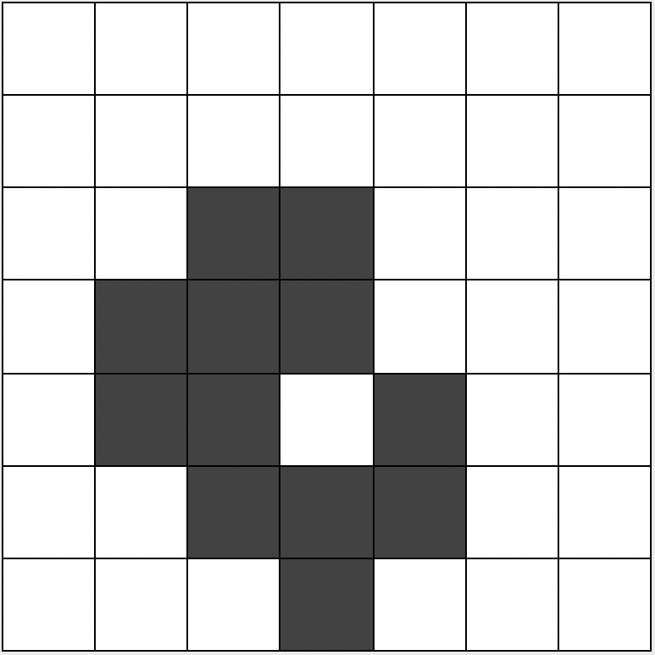
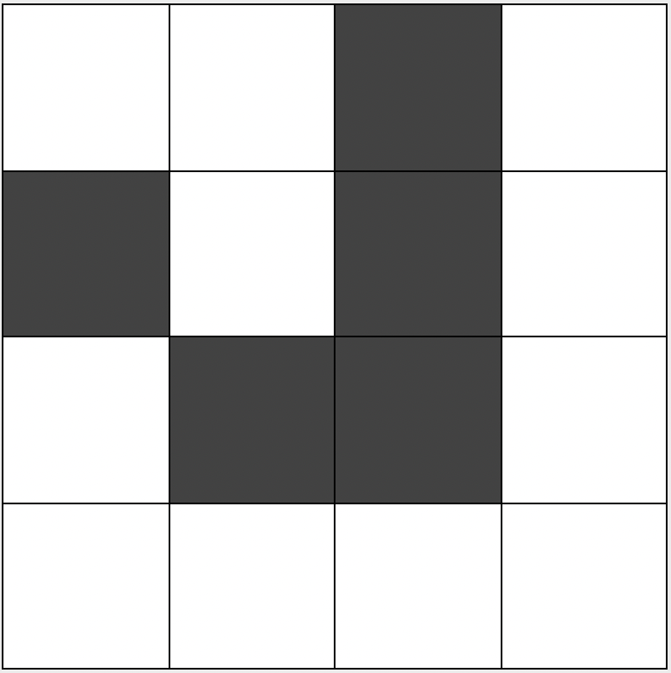
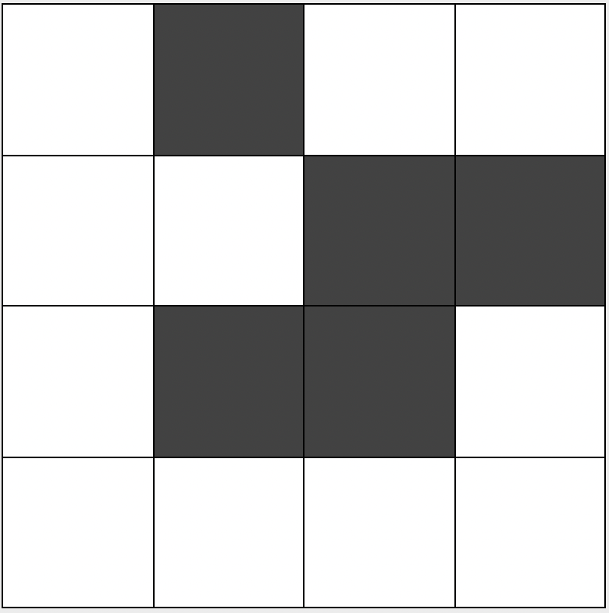
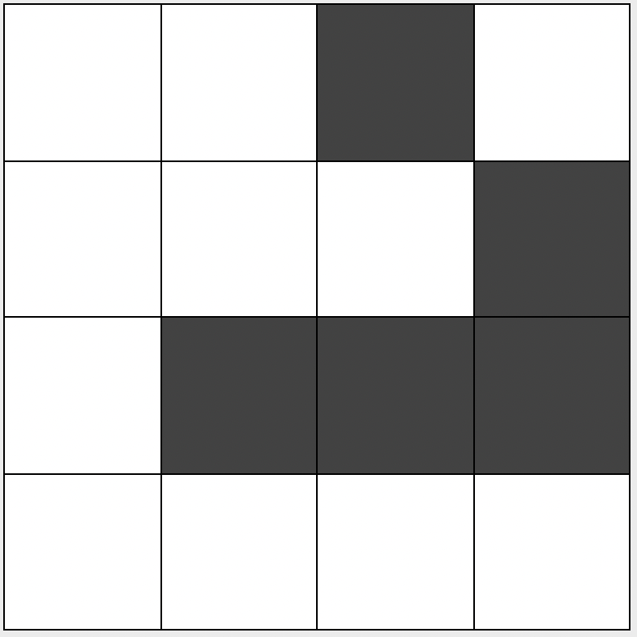
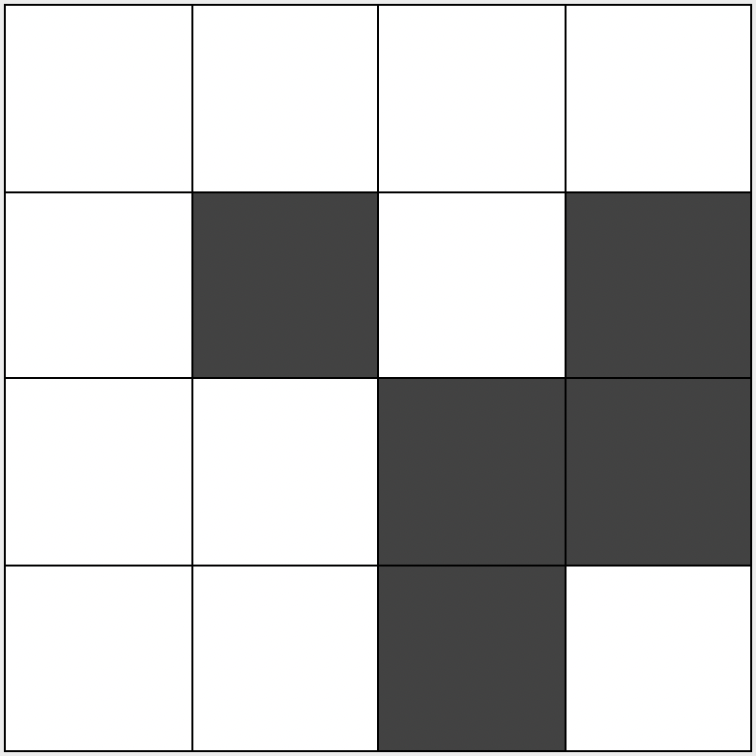
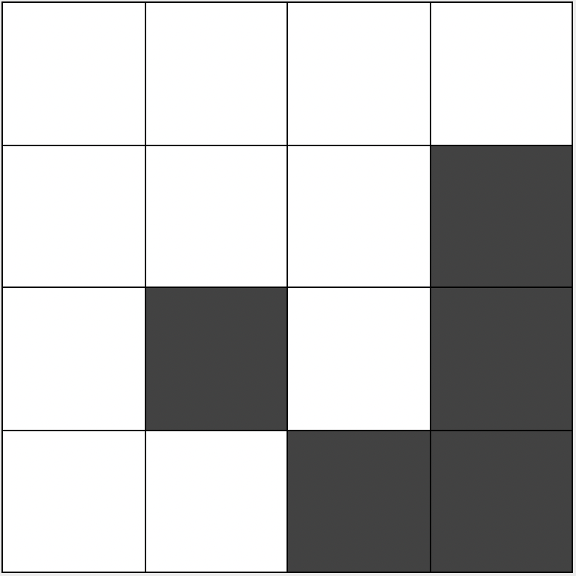

Slide 29
